Slide 1
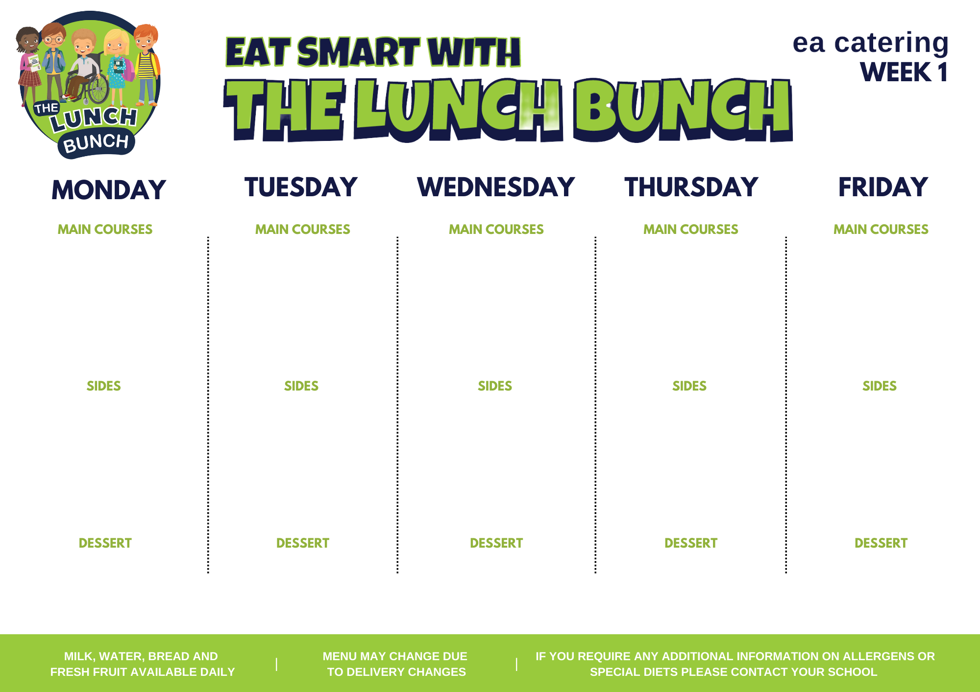
Week commencing
OCT 23, NOV 20, DEC 18, JAN 22
Savoury
Mince
Or
Italian Chicken & Tomato Pasta & Garlic Bread
Classic Margherita
Pizza
Or
Chicken Goujon in Soft Shell Taco & Zingy Tomato Salsa
Roast Chicken
Stuffing
Gravy
Hot Dog
Or
Chicken Panini
Lunch Bunch Chicken Curry & Naan Bread
Or
Cod Fish Goujons
Baton Carrot/Salad
Mashed Potatoes
Baked Beans/Salad/Coleslaw
Diced Potatoes / Baked Potato
Carrots & Broccoli
Mash Potatoes/ Oven Roast Potato/Pasta
Tomato Ketchup/Coleslaw/Salad
Chipped Potatoes/Baked Potato
Garden Peas/Sweetcorn
Steamed Rice
Mash Potatoes
Banana Yoghurt Pot
& iced Fairy cake
Strawberry Mousse & Fruit
Shortbread Biscuit &
Custard
Ice-Cream & Jelly
Chocolate Sponge & Custard

Slide 2
WEEK COMMENCING:
NOV 27, JAN 01, JAN 29
Sausage Roll
Or
Macaroni & Cheese With Crusty Roll
Pasta Bolognaise With
Garlic Bread
Or
BBQ Chicken or Margareta Pizza
Roast of the Day with Stuffing & Gravy
Or
Poached Salmon
Beef Burger in a Bap with Tomato Ketchup
Or
Sweet & Sour Chicken With Rice
Lunch Bunch Chicken Curry & Naan Bread
Or
Lasagna and Crusty Bread
Spaghetti Hoops & Garden Peas
Chipped Potatoes
Sweetcorn/Salad
Oven Roasted Potato Wedges
Broccoli and Carrots
Mashed Potatoes/Oven Roasted Potato/Pasta
Sweetcorn/Salad
Chipped Potatoes/Rice
Garden Peas
Coleslaw
Rice
Ice Cream and Sliced Peaches
Blueberry Muffin
Zesty Orange Sponge
With Custard
Chocolate mousse & Fruit Salad
Flakemeal Biscuit and Yoghurt

Slide 3
WEEK COMMENCING:
NOV 6,
DEC 4, JAN 8, FEB 5
Golden Crumbed Fish Fingers
Or
Mighty Mac ‘n’ Cheese with Garlic Bread Slice
Stir fry Beef with Rice
Or
Pepperoni/Margherita Pizza
Roast Chicken or Beef
Stuffing & Gravy
Mashed Potatoes/Oven Roast Potato/Pasta
Carrots & Peas
Salad
Tasty Pork Sausages with Tomato Ketchup/Gravy
Or
BBQ Chicken Wrap with Crunchy Salad
Lunch Bunch Chicken Curry & Rice
Or
Savory Mince
Mash Potatoes
Baked Beans/Coleslaw
Chipped Potatoes/Mashed Potatoes
Garden Peas/Salad
Homemade Diced Potatoes
Mini Corn on the Cob/Spaghetti Hoops
Chipped Potatoes/Mashed Potatoes
Side Salad/Naan Bread
Artic Roll with Two Fruits
Jelly or Rice Pudding
Iced Cake & Custard
Ice-Cream & Fruit salad
Lemon Drizzle Cake & Custard

Slide 4
WEEK COMMENCING:
NOV 13,
DEC 11, JAN 15, FEB 12
Beef Bolognaise with Garlic Bread
Or
Cod Fishcakes with Tartare Sauce
Margareta Cheese Pizza or Pepperoni
Or
Tex Mex Beef & Veg Enchilada
Roast Chicken
Stuffing
Gravy
Or
Stuffed Chicken
Oven Baked Chicken Goujons
Or
Sweet Chilli Chicken Panini
Lunch Bunch Chicken Curry & Naan Bread
Or
Mac ’n’ Cheese
With Crusty Baguette
Garden Peas
Oven Baked Potato Wedges / Mash Potatoes
Sweetcorn and Red Pepper/Coleslaw
Chipped Potatoes/Baked Potato
Broccoli/Carrots
Mashed Potatoes/Oven Roast Potato/Pasta
Salad/Baked Beans
Chipped Potatoes/Mashed Potatoes
Green Beans
Steamed Rice
Jam & Coconut Sponge with Custard
Jelly or Rice Pudding & Peaches
Strawberry Ice Cream
Homemade Ginger Biscuit and Fruit
Cornflake Tart & Custard

